Slide 1
MAIL SERVER
GROUP 2
30/3/2018

Slide 2
GROUP MEMBERS
Menaga -093959
Navya Rani* -093953
Paila Sujana -094001
Ayub Nadaf -094047
Prem Singh Rawat -093999
Mohammad Abdul Jabbar -093958
Raj Subash B -093964

Slide 3
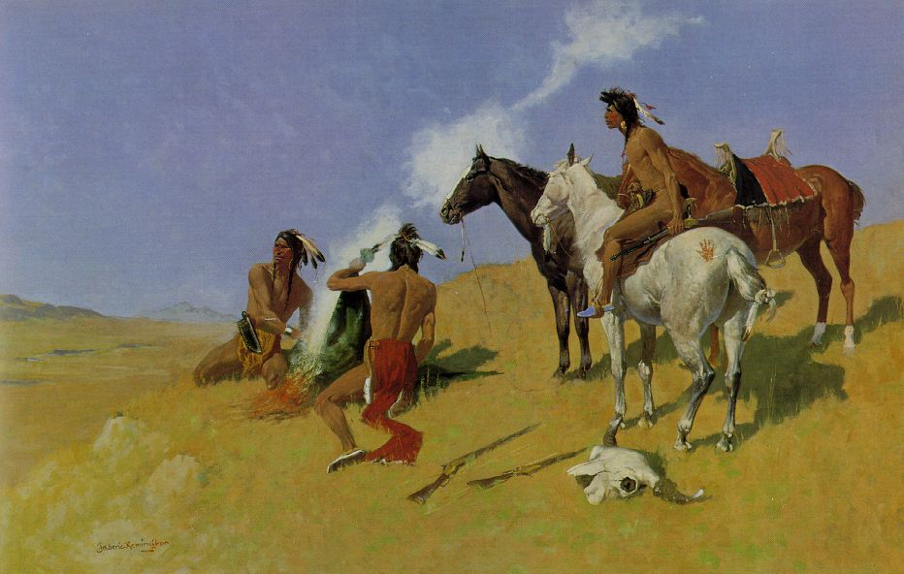

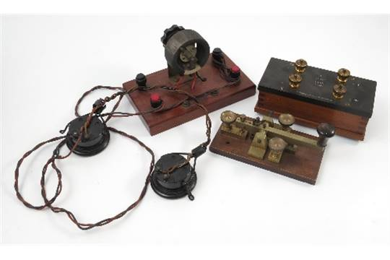
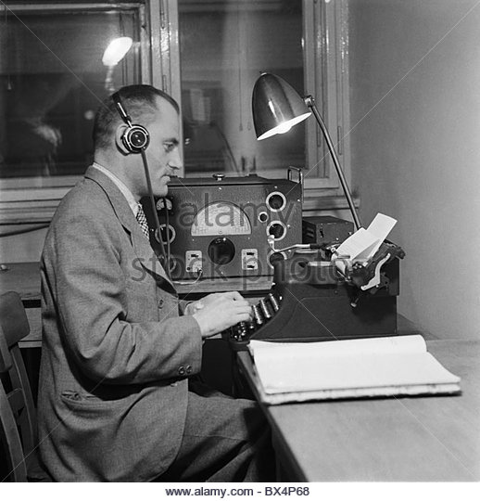
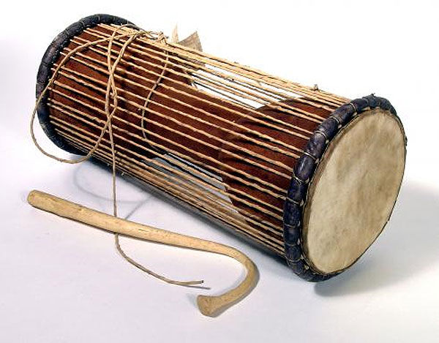
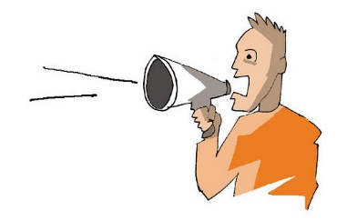

Slide 4

E-MAIL
Electronic Mail (email or e-mail) is a method of exchanging messages ("mail") between people using electronic devices.
Email first entered limited use in the 1960s and by the mid-1970s had taken the form now recognized as email.
Email operates across computer networks, which today is primarily the Internet.
The first e-mail was sent by Ray Tomlinson in 1971.

Slide 5


E-MAIL & POSTAL MAIL
E-MAIL
POSTAL MAIL
E-mail takes few seconds to deliver the message all around the world.
E-mail costs just the cost of a local phone call.
A carbon copy of mail can be sent to the other people.
E-mail passed from one computer to other over the network.
Rate independent of quality and data type.
According to Law, an e-mail is considered as legal.
They may take longer time 4 to 5 days depending on the destination.
Costs depends on the national and international tariff rates.
Different envelops are needed to send the same message to many people.
This stops at different postal stations which comes on the way.
Rate depends on the weight of mailing document and destination.
Postal mail documents are valid proofs and also legal.

Slide 6
E-MAIL ONLINE:
The way of sending and receiving e-mail is an online e-mail service or webmail.
Examples: Hotmail (now Outlook.com), Gmail, and Yahoo Mail.
The “To” field is that where you send the e-mail address of the person and “From” shows your e-mail address.
The Subject should consist of few words describing the e-mails content and it represent what the e-mail is about without opening and reading the full e-mail.
Cc (Carbon Copy) - Put the email addresses here if you are sending a copy for their information (and you want everyone to explicitly see this).
Bcc (Blind Carbon Copy) - Put the email address here if you are sending them a Copy and you do not want the other recipients to see that you sent it to this contact.
Finally, the Message Body is the location you type your main message. It often contains your signature at the bottom; similar to a hand-written letter.

Slide 7
WHY WE USE E-MAIL:
We can send message anytime anywhere.
E-mail is in written, you can compose and review your message before sending.
We can send and forward the same message to several people at same time around the world.
We can save the time, E-mail is very fast, usually take very less time to receive.
You may attach files, documents, images, & other media to an email.
You can access your email from anywhere with Internet connection kept on.
It allows to save & keep a record of your communication.

Slide 8
MUA(MAIL USER AGENT)
The Mail User Agent (MUA) is an application which is used to compose, send, and receive emails.
Writes e-mail to MTA using SMTP (usually).
Reads e-mail delivered by MDA.
Examples: Mozilla Thunderbird, Outlook Express.
Format outgoing messages with proper header information and encode the outgoing messages for use by Mail Delivery Agents in routing the messages.
Allow users to read, save, and delete incoming electronic mail messages.
Schedule MIME Applications to allow the user to experience non-textual information attached to incoming electronic mail.
Example: Viewing graphics files or video clips, or listening to audio data.

Slide 9
MTA(MESSAGE TRANSFER AGENT)
MTA is a software application used within an Internet message handling system (MHS). It is responsible for transferring and routing an electronic mail message from the sender’s computer to the recipient’s computer.
The main function of the MTA is forwarding the incoming message to the proper end-user or destination. MTA is also known as mail relay.
The MTA’s operational activities are always performed on the back end, but a user is unaware of these because he or she will interact with an email client interface.
Some major functions of MTA :
Receiving all messages that are transmitted from other user agents for further transmission.
Keeping track of each and every activity and analyzing and storing the recipient list to perform future routing functions.
Sending auto-responses about non delivery when a message does not reach its intended destination.

Slide 10
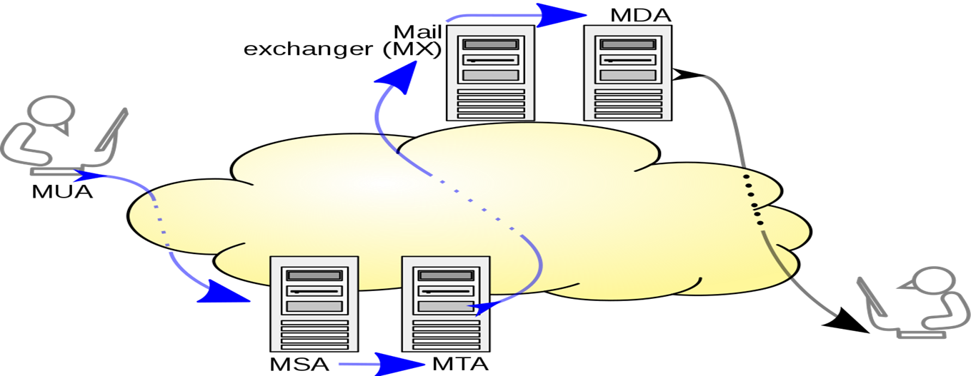
MDA / LDA
MDA is a Mail Delivery Agent (or) Message Delivery Agent and LDA is a Local Delivery Agent.
MDA is a computer software component that is responsible for the delivery of e-mail messages to a local recipient's(clients) mailbox.
Within a destination mail server, local MDA accepts an incoming email from remote MTA.
MDA’s do not transport messages between systems or interface only with the end user.
Delivers mail to other MTA.

Slide 11
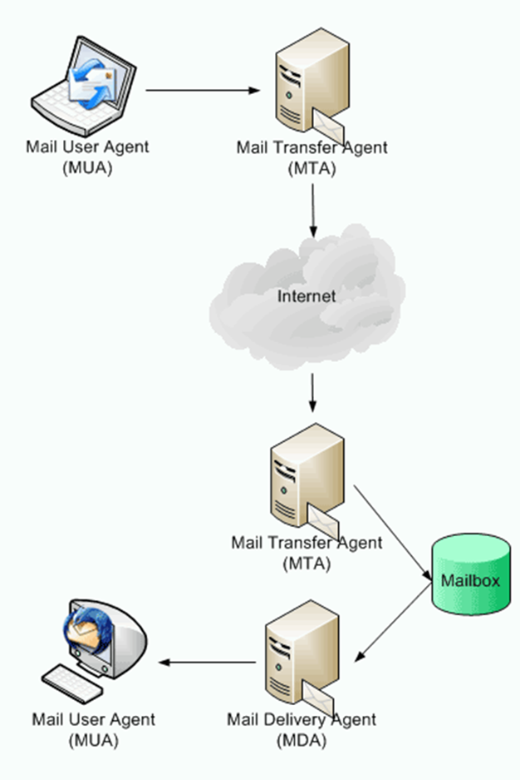
MDA/LDA
The recipient’s MTA receives the email and passes it on to a Mail Delivery Agent (MDA). An MDA manages the user’s mailbox and handles mails for delivery to the MUA using either the POP or IMAP protocol.
MDA Software
Proc mail
Mail drop
Dovecot
Postfix
Cyrus

Slide 12
SMTP
What is SMTP?
Simple Mail Transfer Protocol
SMTP server – every email client interfaces to send email
List of SMTP servers in transit - Check the headers on your email!
Port no:25

Slide 13
MULTIPART MESSAGES
But can we send multipart messages with attachments?
YES
SMTP is only a delivery mechanism, nothing to do with contents
Your assignment
Simple text

Slide 14
POP3
It is a simple protocol used for opening the remote e-mail boxes.
This protocol is defined in RFC 1225.
Post Office Protocol version 3 (POP3) is a message access protocol that enables the client to fetch an e-mail from the remote mail server.
A POP3 server stores messages for each user until the user connects to download and read them using a POP3 client

Slide 15
COMMANDS IN POP3
stat: It asks the server for the number of messages waiting to be retrieved.
list: It determines the size of each message to be retrieved.
retr: It retrieves individual messages .
Quit: Ends the POP3 session.

Slide 16
MAIL ACCESS BY POP3
The client POP3 software is installed on the receiver's computer the server POP3 software is installed on the mail server.
POP3 uses well-known TCP port 110.
The communication procedure is similar to SMTP and uses ASCII characters.
POP3 begins when user starts the mail reader.
The mail reader calls up the ISP (or mail server) and establishes a TCP connection with the message transfer agent at port 110.

Slide 17
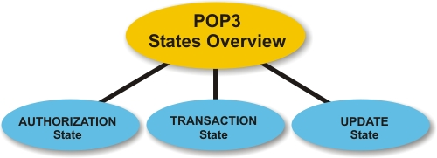
POP3 STATES

Slide 18
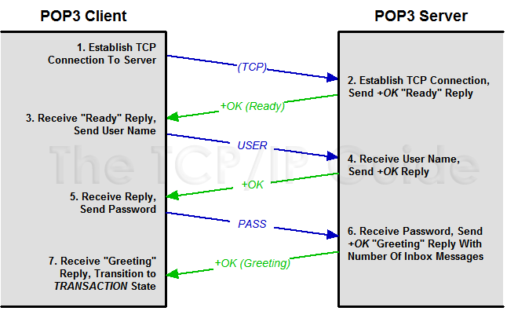
AUTHORIZATION STATE

Slide 19
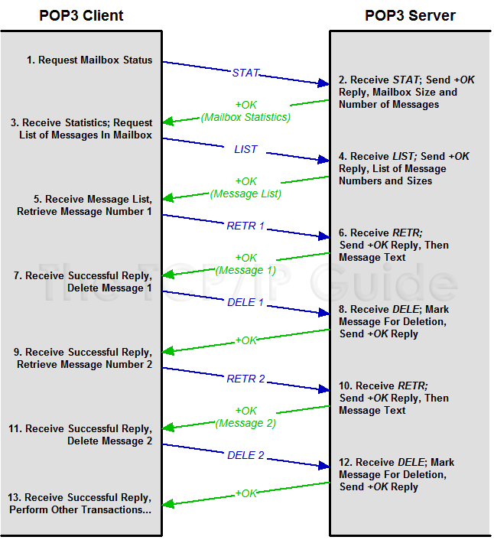
TRANSACTION STATE

Slide 20
UPDATION STATE
When the POP3 client is done with its e-mail transactions, it issues the QUIT command.
This causes the Update state to be automatically entered, where the server performs necessary clean-up operations, including deleting any messages marked for deletion in the Transaction state.

Slide 21
ABOUT IMAP
Internet Message access protocol.
1986, Stanford University.
It is used to access messages from more than one computer.
Port number is 143.
IMAP over SSL (IMAPS) is assigned the port number 993.
Used for accessing electronic mail that are kept on server.

Slide 22
IMAP4
Internet Message Access Protocol (IMAP) is an Internet standard protocol used by e-mail clients to retrieve e-mail messages from a mail server over a TCP/IP connection.
The Internet Message Access Protocol is an Application Layer Internet protocol that allows an e-mail client to access e-mail on a remote mail server.
IMAP supports both on-line and off-line modes of operation. E-mail clients using IMAP generally leave messages on the server until the user explicitly deletes them.

Slide 23
Multiple clients can talk to the same account on the same server – from anywhere
IMAP Server
IMAP Server
Clients can talk to multiple servers
Mail
folders
Mail
folders
IMAP client
IMAP client
Client has full control over their mail folders. Can create, delete or move them around – even between different accounts on different servers
Client decides where to store messages. Copy them locally or leave them on the server.
Mail
folders
Mail
folders

Slide 24
INTERACTION BETWEEN CLIENT AND SERVER
Client sends data – server receives:
Client command begins with alphanumeric string (‘tag ’) e.g. A001 which is created for every new command.
Then the command with corresponding arguments follows
Server sends data – client receives
Server receives and works with command
Return the same tag with a state (OK/NO/BAD)
Additional information begin with ‘*’ (untagged)
Untagged in formation can be sent at every time

Slide 25
ADVANTAGES OF IMAP4
You can keep a local archive, as well as rest assured knowing a copy is stored on the mail server.
With a persistent Internet connection, only email headers are downloaded, so you can see your mail faster. The full message is only downloaded when you request to read it.
Size of your message archive is limited only by your account’s server space, not your personal device(s).

Slide 26
MAPI
MAPI interface is required for interfacing messaging-based services to client applications such as Outlook.
For example, several non-Microsoft e-mail server product vendors created "MAPI service providers" to allow their products to be accessed via Outlook.
While MAPI is designed to be independent of the protocol, it is usually used with MAPI over HTTP or MAPI/RPC, protocols used by Microsoft Outlook communicate with Microsoft Exchange Server.

Slide 27
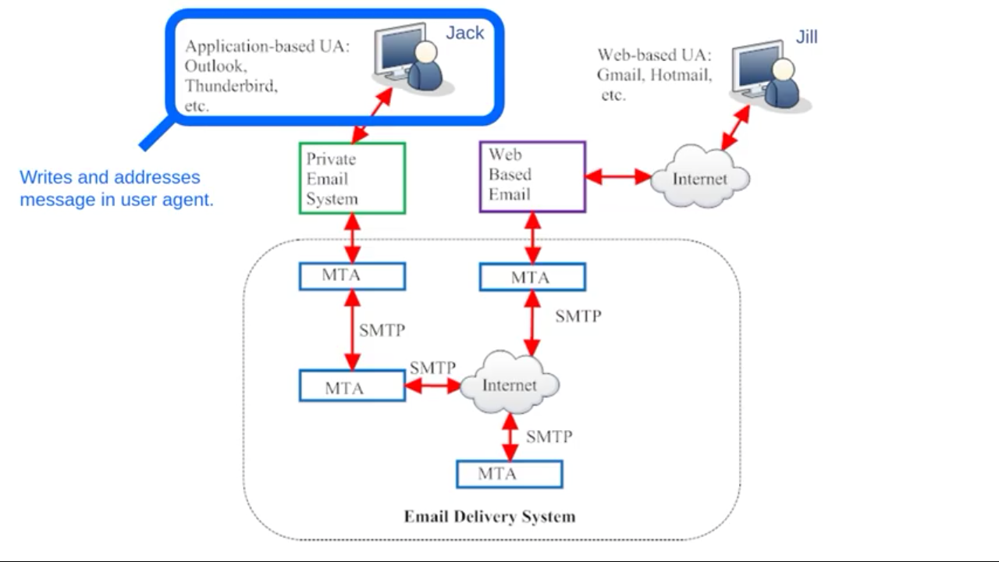

Slide 28
Alice
Bob
Reduced header
TO: Bob@dougj.com
Hello Bob
From:alice@iseag.com
Hello Bob
UA
UA
UA Header from:alice@iseag.com
MTA2 Header
MIME Header
MTA1 Header
Hello Bob
UA Header from:alice@iseag.com
MAT2 dougj.net
MIME Header
MAT iseage.net
SMTP
Internet
Hello Bob
MTA2 Header
MTA1 Header
MTA1 Header
UA Header from:alice@iseag.com
UA Header from:alice@iseag.com
MIME Header
MIME Header
Hello Bob
Hello Bob

Slide 29
THANK YOU

